Slide 1
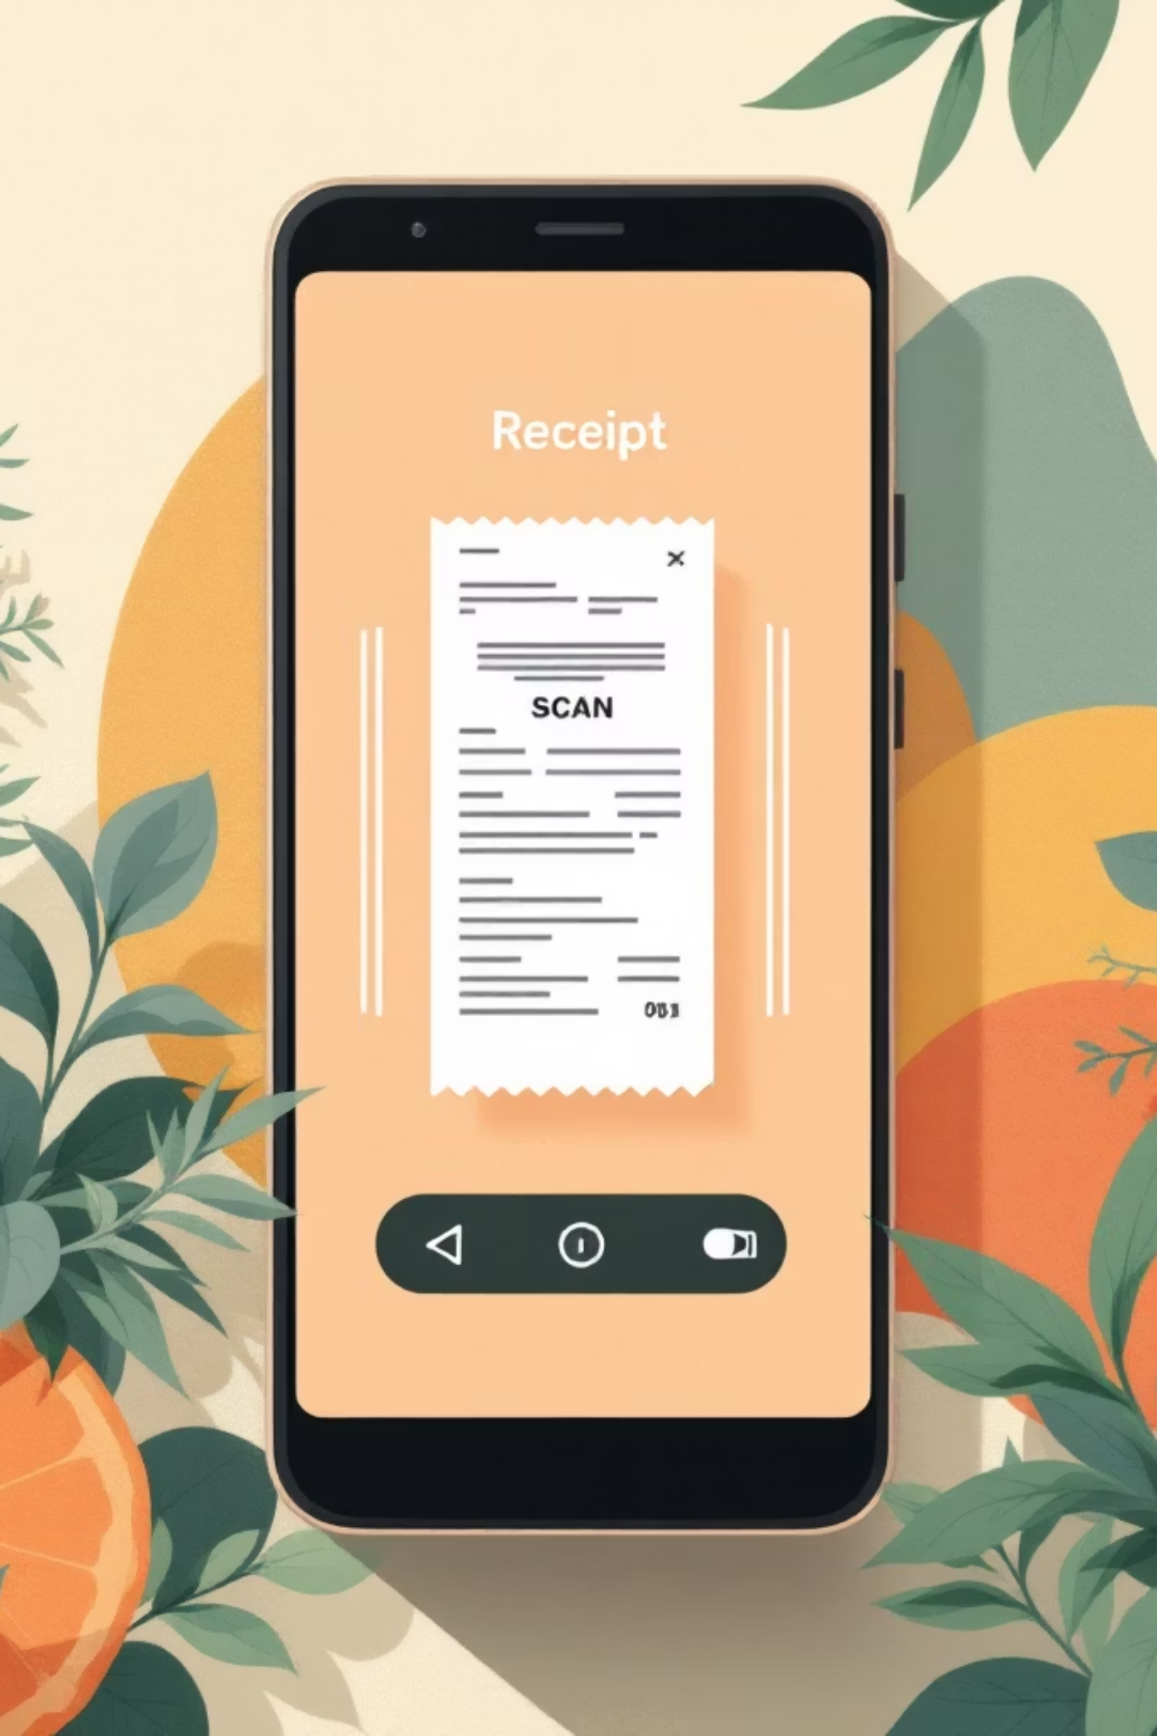
Infosys Springboard
Receipt & Invoice Digitizer
Mentor: Shakthi GopalaKrishnan
Team Members- Ankit Sharma
Hemanjali Kodali
Sandana Aini
Rethika
Nirupama Pardhu Nakketla

Slide 2


Team Introduction
Team A
Ankit Sharma
Backend Development & Dashboard Implementation
Hemanjali Kodali
User Dashboard & Receipt Digitization Functionality
Rethika
Landing Page Design
Sandana Aini
Chatbot Development
Nirupama Pardhu Nakketla
UI/UX Enhancement

Slide 3
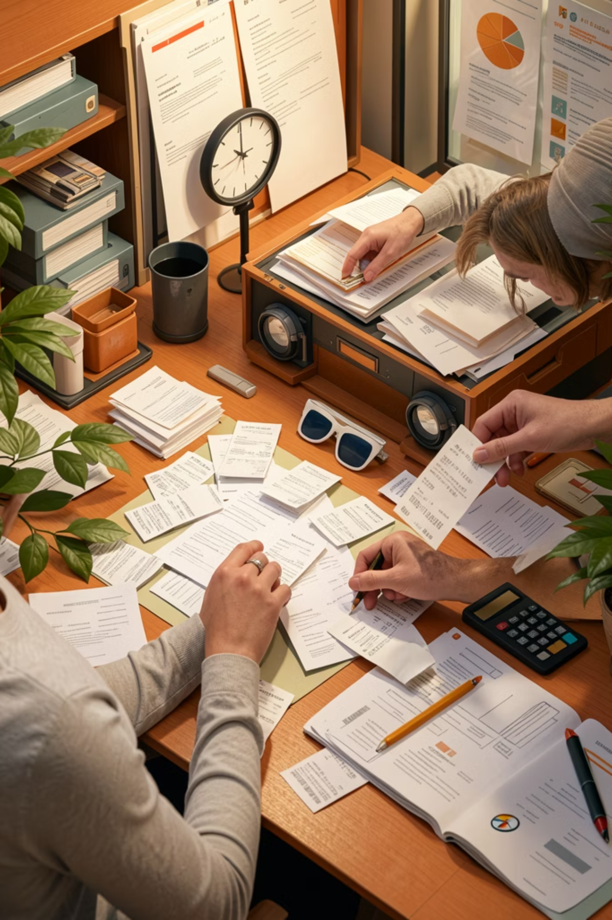
Problem Statement
Managing receipts manually is inefficient and inconvenient:
Receipts can be easily lost or damaged
Manual data entry takes too long
Hard to organize and track expenses
No clear insights into spending behavior
No digital backup for records
Hard to analyze spending over time
Receipts fade, curl, or become unreadable
Searching old receipts is frustrating
Paper clutter creates compliance risk

Slide 4
Objective
The goal of this project is to build a system that:
Automatically extracts data from receipts
Converts unstructured data into structured format
Stores receipt information digitally
Provides analytics for expense tracking
Assists users through an interactive chatbot

Slide 5

Architecture & Workflow
Upload
AI Process
Display
Submit receipt image or PDF
Structure data via Gemini AI
Show results and analytics on frontend
OCR
Store
Extract raw text with Tesseract
Persist in FastAPI + SQL backend

Slide 6





Technology Stack
Built with a modern, end-to-end stack for a smooth receipt capture and analytics experience.
Frontend
Backend
AI & OCR
React
Tailwind CSS
Recharts (for data visualization)
FastAPI (Python)
Tesseract OCR
Gemini AI
Database
Tools Used
SQL Database
GitHub (version control)
VS Code (development)

Slide 7
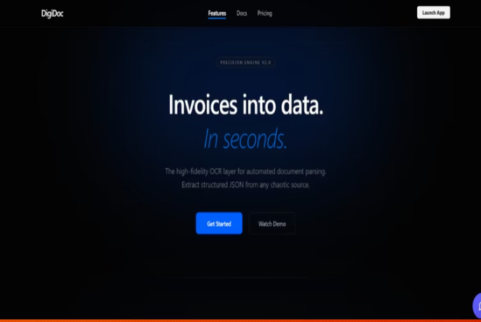
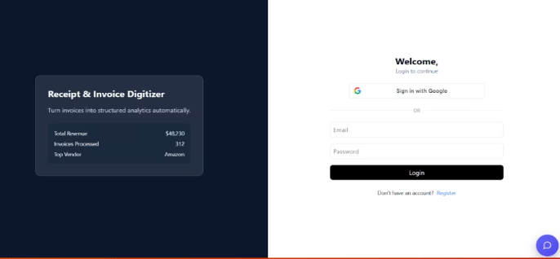
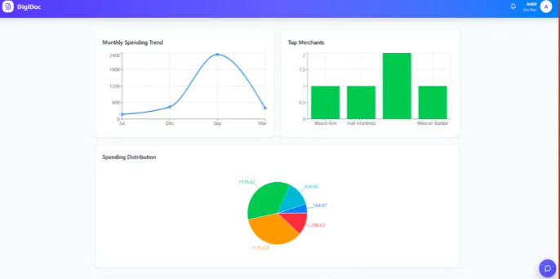
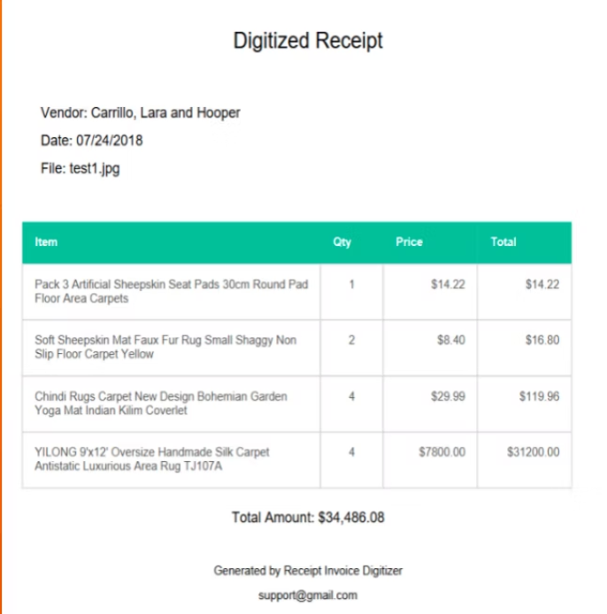
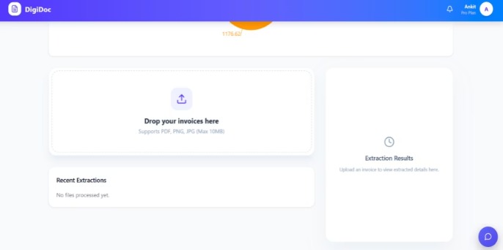
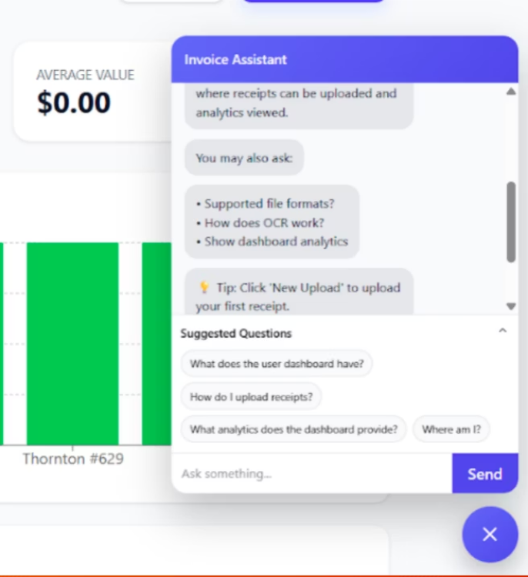
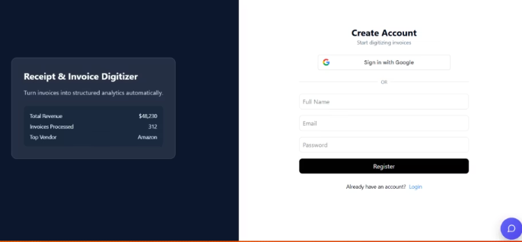
Screenshots And Interface
Key screens from the app, shown in a wider compact grid for easier comparison.
Landing Page
Login
Analytics
Digitized Receipt
Welcoming first view.
Streamlined sign-in screen.
Clear performance insights.
Structured extracted data.
Dashboard
Chatbot
Central workspace overview.
AI assistant for support.
Registration
Simple sign-up flow.

Slide 8
Feature Enhancements
We added several features to improve usability:
Analytics Dashboard
Receipt Download Feature
Chatbot Integration
For visual insights
For saving data
For user assistance
Dark Mode UI
Automatic Item Extraction
For better experience
For detailed data
Future Enhancements
Mobile application
Budget tracking features
Advanced AI-based insights

Slide 9
Conclusion
The Receipt & Invoice Digitizer successfully achieves its objectives:
Automates receipt digitization using OCR
Extracts key details using AI
Stores data digitally for easy access
Provides analytics for better expense understanding
Overall, the system improves efficiency and demonstrates how AI and automation can simplify financial management.

Slide 10

Thank You

